Slide 1
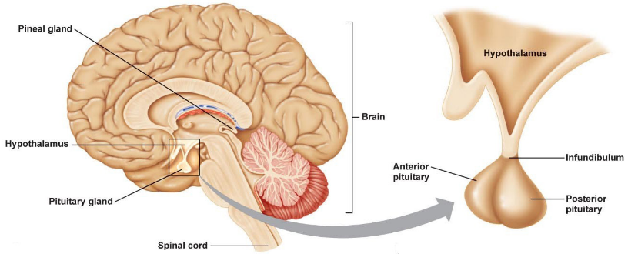
The hypothalamus and pituitary
Ch 2 Chemical Messengers

Slide 2

Date: | Human Biology Year 12 ATAR
Do Now Do the past exam question given ☺ Lesson Agenda 1: Do Now 2: The hypothalamus and pituitary ppt presentation 3: Complete Review Worksheet and check answers 4: Lesson summary and wind-up Suggested Study Complete, mark and correct review worksheet NEXT LESSON Past Exam Question on today’s work (not for marks) Growth Hormone production and regulation | Learning Aims Describe the location of the hypothalamus and its basic functions. Describe the structure and location of the pituitary gland. List the releasing factors that are produced by the hypothalamus. Describe how the releasing hormones travel from the hypothalamus to the anterior pituitary. Link the releasing factors from the hypothalamus to the anterior pituitary hormones they stimulate. Describe the functions of the hormones produced and released by the anterior pituitary Describe the functions of the posterior pituitary gland Comment on where the hormones released by the posterior pituitary are manufactured. Comment on the differences between the anterior and posterior pituitary. Describe the regulation of posterior pituitary hormones
 | Key Vocabulary Anterior Posterior Infundibulum Hypothalamus Pituitary

Slide 3
The Hypothalamus and Pituitary
Work together to control many of the other endocrine glands – hormone homeostasis
Located in brain:

Slide 4
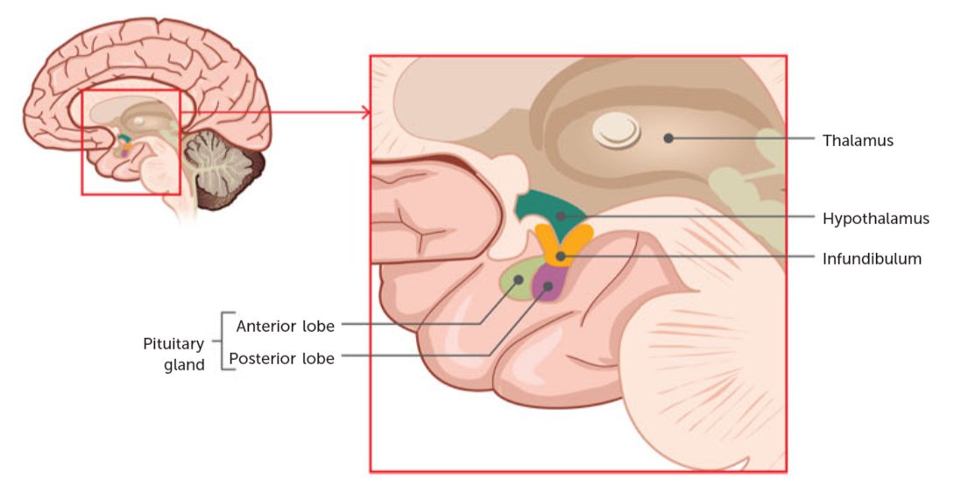
The Hypothalamus
Has roles in both the endocrine and nervous systems – acts as a connector between the two.
Regulates many basic functions of the body:
Body Temperature
Water Balance
Heart Rate
Secretion of Releasing Factors and Inhibiting factors
that stimulate the anterior pituitary to produce other
hormones or to inhibit the release of hormones.
Production of hormones that travel along nerves and are released by the posterior pituitary.
Located in the base of the brain, below the thalamus and above pituitary.
Learning Aim: Describe the location of the hypothalamus and its basic functions

Slide 5
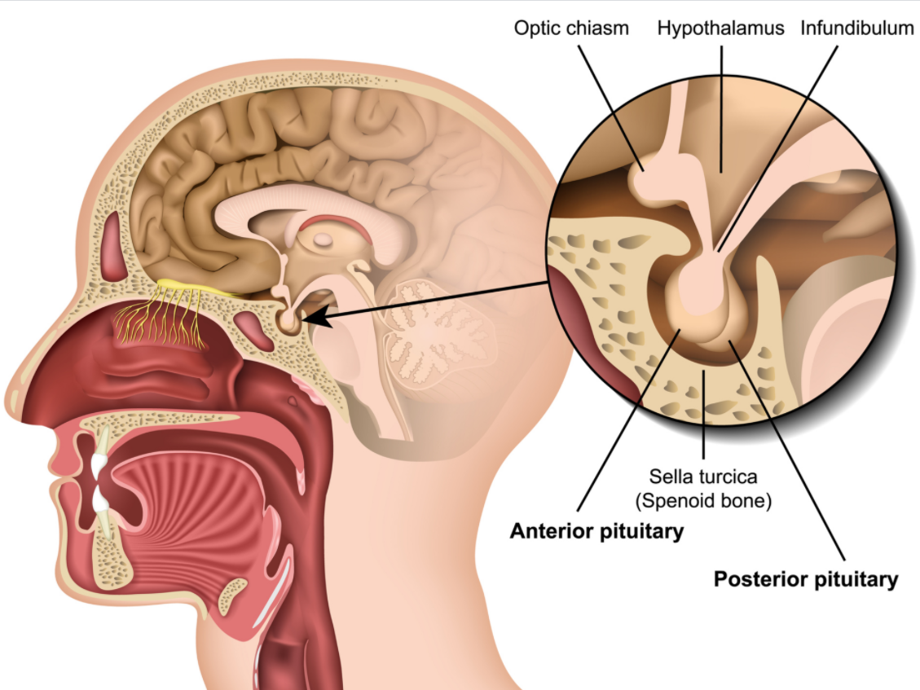
The Pituitary Gland
Also called the hypophysis, sometimes called the “master gland”.
Lies just beneath the hypothalamus in a pocket of bone.
Joined to the hypothalamus by a stalk called the infundibulum.
The infundibulum contains blood vessels and nerves that communicate with the pituitary.
Two lobes that function separately:
Anterior Lobe – closest to front of body.
Receives releasing factors from the hypothalamus via blood vessels in the infundibulum.
Produces hormones in response to stimulus by hypothalamus and releases them into systemic circulation (the blood stream supplying the body).
Posterior Lobe – closest to back of body.
Does not make its own hormones.
Releases hormones made by the hypothalamus that travel down the infundibulum via nerves.
Learning Aim: Describe the structure and location of the pituitary gland.

Slide 6
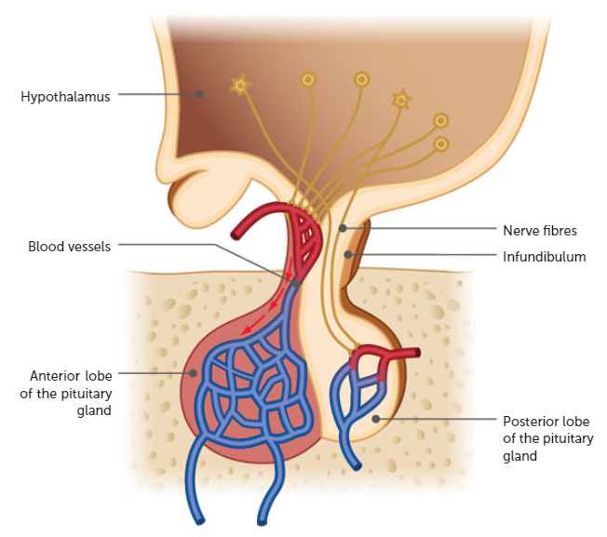
Communication between Hypothalamus and Anterior Pituitary
1: the hypothalamus produces releasing factors.
2: these are secreted into the blood vessels of the infundibulum.
3: releasing factors travel through these blood vessels to the anterior pituitary.
4: the releasing factors stimulate the anterior pituitary to produce and release other hormones.
5: the hormone produced is released into the systemic
circulation
Releasing Factors from the Hypothalamus Include:
TRF: Thyrotropin Releasing Factor
CRF: Corticotropin Releasing Factor
GHRF: Growth Hormone Releasing Factor
PRF: Prolactin Releasing Factor
GnRF: Gonadotropin Releasing Factor
Inhibiting Factors from the Hypothalamus Include:
PIF: Prolactin Inhibiting Factor (also called Dopamine)
GHIF: Growth Hormone Inhibiting Factor (also called Somatostatin)
Learning Aim: List the releasing factors that are produced by the hypothalamus
Learning Aim: Describe how the releasing hormones travel from the hypothalamus to the anterior pituitary.

Slide 7
The Anterior Pituitary
Also called the adenohypophysis
Produces and releases a number of hormones in response to releasing factors from the hypothalamus.
Hypothalamus Produces: | Releasing/ Inhibiting factors travel via the blood vessels of the infundibulum to the Anterior Pituitary | In response, the Anterior Pituitary
TRF Thyrotropin Releasing Factor |  | Produces and releases TSH: Thyroid Stimulating Hormone into the systemic circulation
CRF Corticotropin Releasing Factor |  | Produces and releases ACTH: Adrenocorticotropic Hormone into the systemic circulation
GHRF Growth Hormone Releasing Factor |  | Produces and releases Growth Hormone into the systemic circulation
PRF Prolactin Releasing Factor |  | Produces and releases Prolactin into the systemic circulation
GnRF Gondaotropin Releasing Factor |  | Produces and releases LH: Luteinising Hormone and FSH: Follicle Stimulating Hormone into the systemic circulation
PIF Prolactin Inhibitory Factor |  | Inhibits release of Prolactin
GHIF Growth Hormone Inhibitory Factor |  | Inhibits release of Growth Hormone
Learning Aim: Link the releasing factors from the hypothalamus to the anterior pituitary hormones they stimulate.

Slide 8
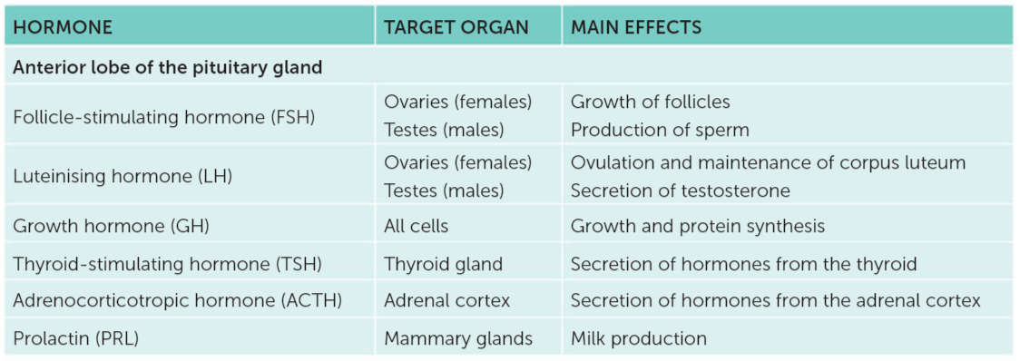
Anterior Pituitary Hormone Functions:
Learning Aim: Describe the functions of the hormones produced and released by the anterior pituitary

Slide 9
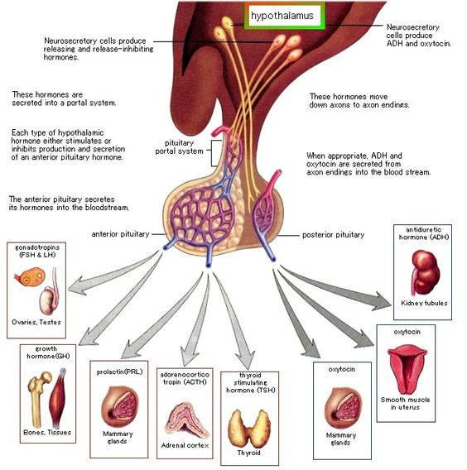
Anterior Pituitary Hormone Functions:

Slide 10
The Posterior Pituitary
Also called the neurohypophysis.
Does not manufacture hormones of its own.
Hormones are made in the hypothalamus and travel through nerve fibre extensions in the infundibulum and are released from the posterior pituitary in response to nerve impulses.
Learning Aim: Describe the functions of the posterior pituitary gland.

Slide 11
Communication between Hypothalamus and Posterior Pituitary
1: the hypothalamus manufactures the hormones oxytocin and ADH: Anti-Diuretic Hormone
2: these travel down the nerve fibres within the infundibulum to the posterior pituitary.
3: The hormones are then released into the systemic circulation by the posterior pituitary in response to nerve impulses.
Posterior Pituitary Hormones and Actions:
Oxytocin
Stimulates uterine contractions.
Stimulates milk ejection from mammary glands.
Anti-Diuretic Hormone
Also called vasopressin.
Causes kidneys to reabsorb water from urine that is forming, and return it to the blood stream – helps to retain fluid in the body.
Can also cause constriction of arterioles at high concentrations.
Learning Aim: Describe the functions of the posterior pituitary gland.
Learning Aim: Comment on where the hormones of the posterior pituitary are manufactured.

Slide 12
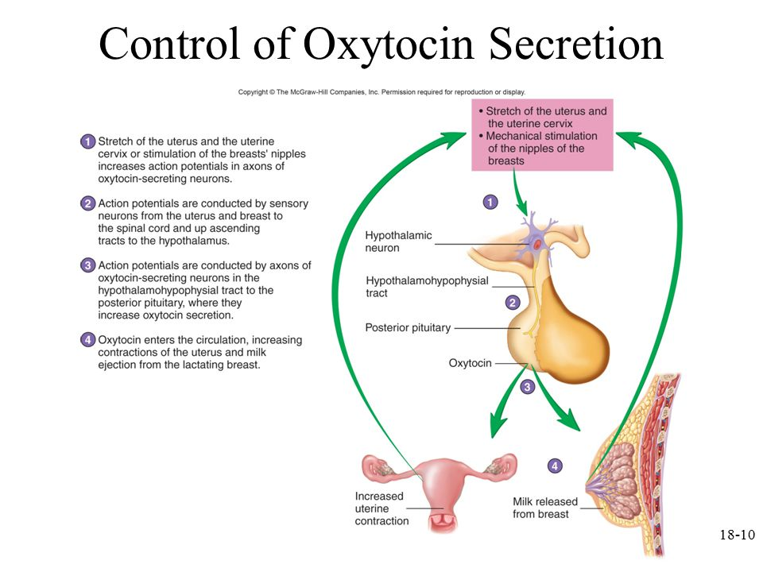
Regulation of Posterior Pituitary Hormones
Learning Aim: Describe the regulation of posterior pituitary hormones

Slide 13
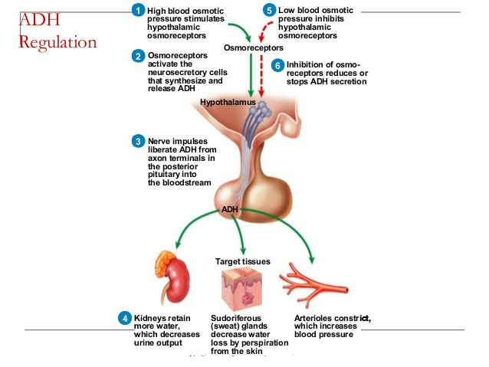
Regulation of Posterior Pituitary Hormones
Example: ADH regulation
Learning Aim: Describe the regulation of posterior pituitary hormones

Slide 14
Compare Anterior and Posterior Pituitary
 | Anterior Pituitary | Posterior Pituitary
Location | Beneath Hypothalamus | Beneath Hypothalamus
Connection to Hypothalamus | Blood Vessels in the Infundibulum | Long nerve fibres running through the infundibulum
Structure | Secretory cells | Nerve fibres from hypothalamus
Makes hormones | Yes, lots of them | No, just releases hormones made in the hypothalamus
Stimulated by | Releasing Factors from hypothalamus | Nerve signals in the fibres from the hypothalamus
Releases Hormones | Into systemic circulation | Into systemic circulation
Learning Aim: Comment on the differences between the anterior and posterior pituitary.

Slide 15
